Slide 1

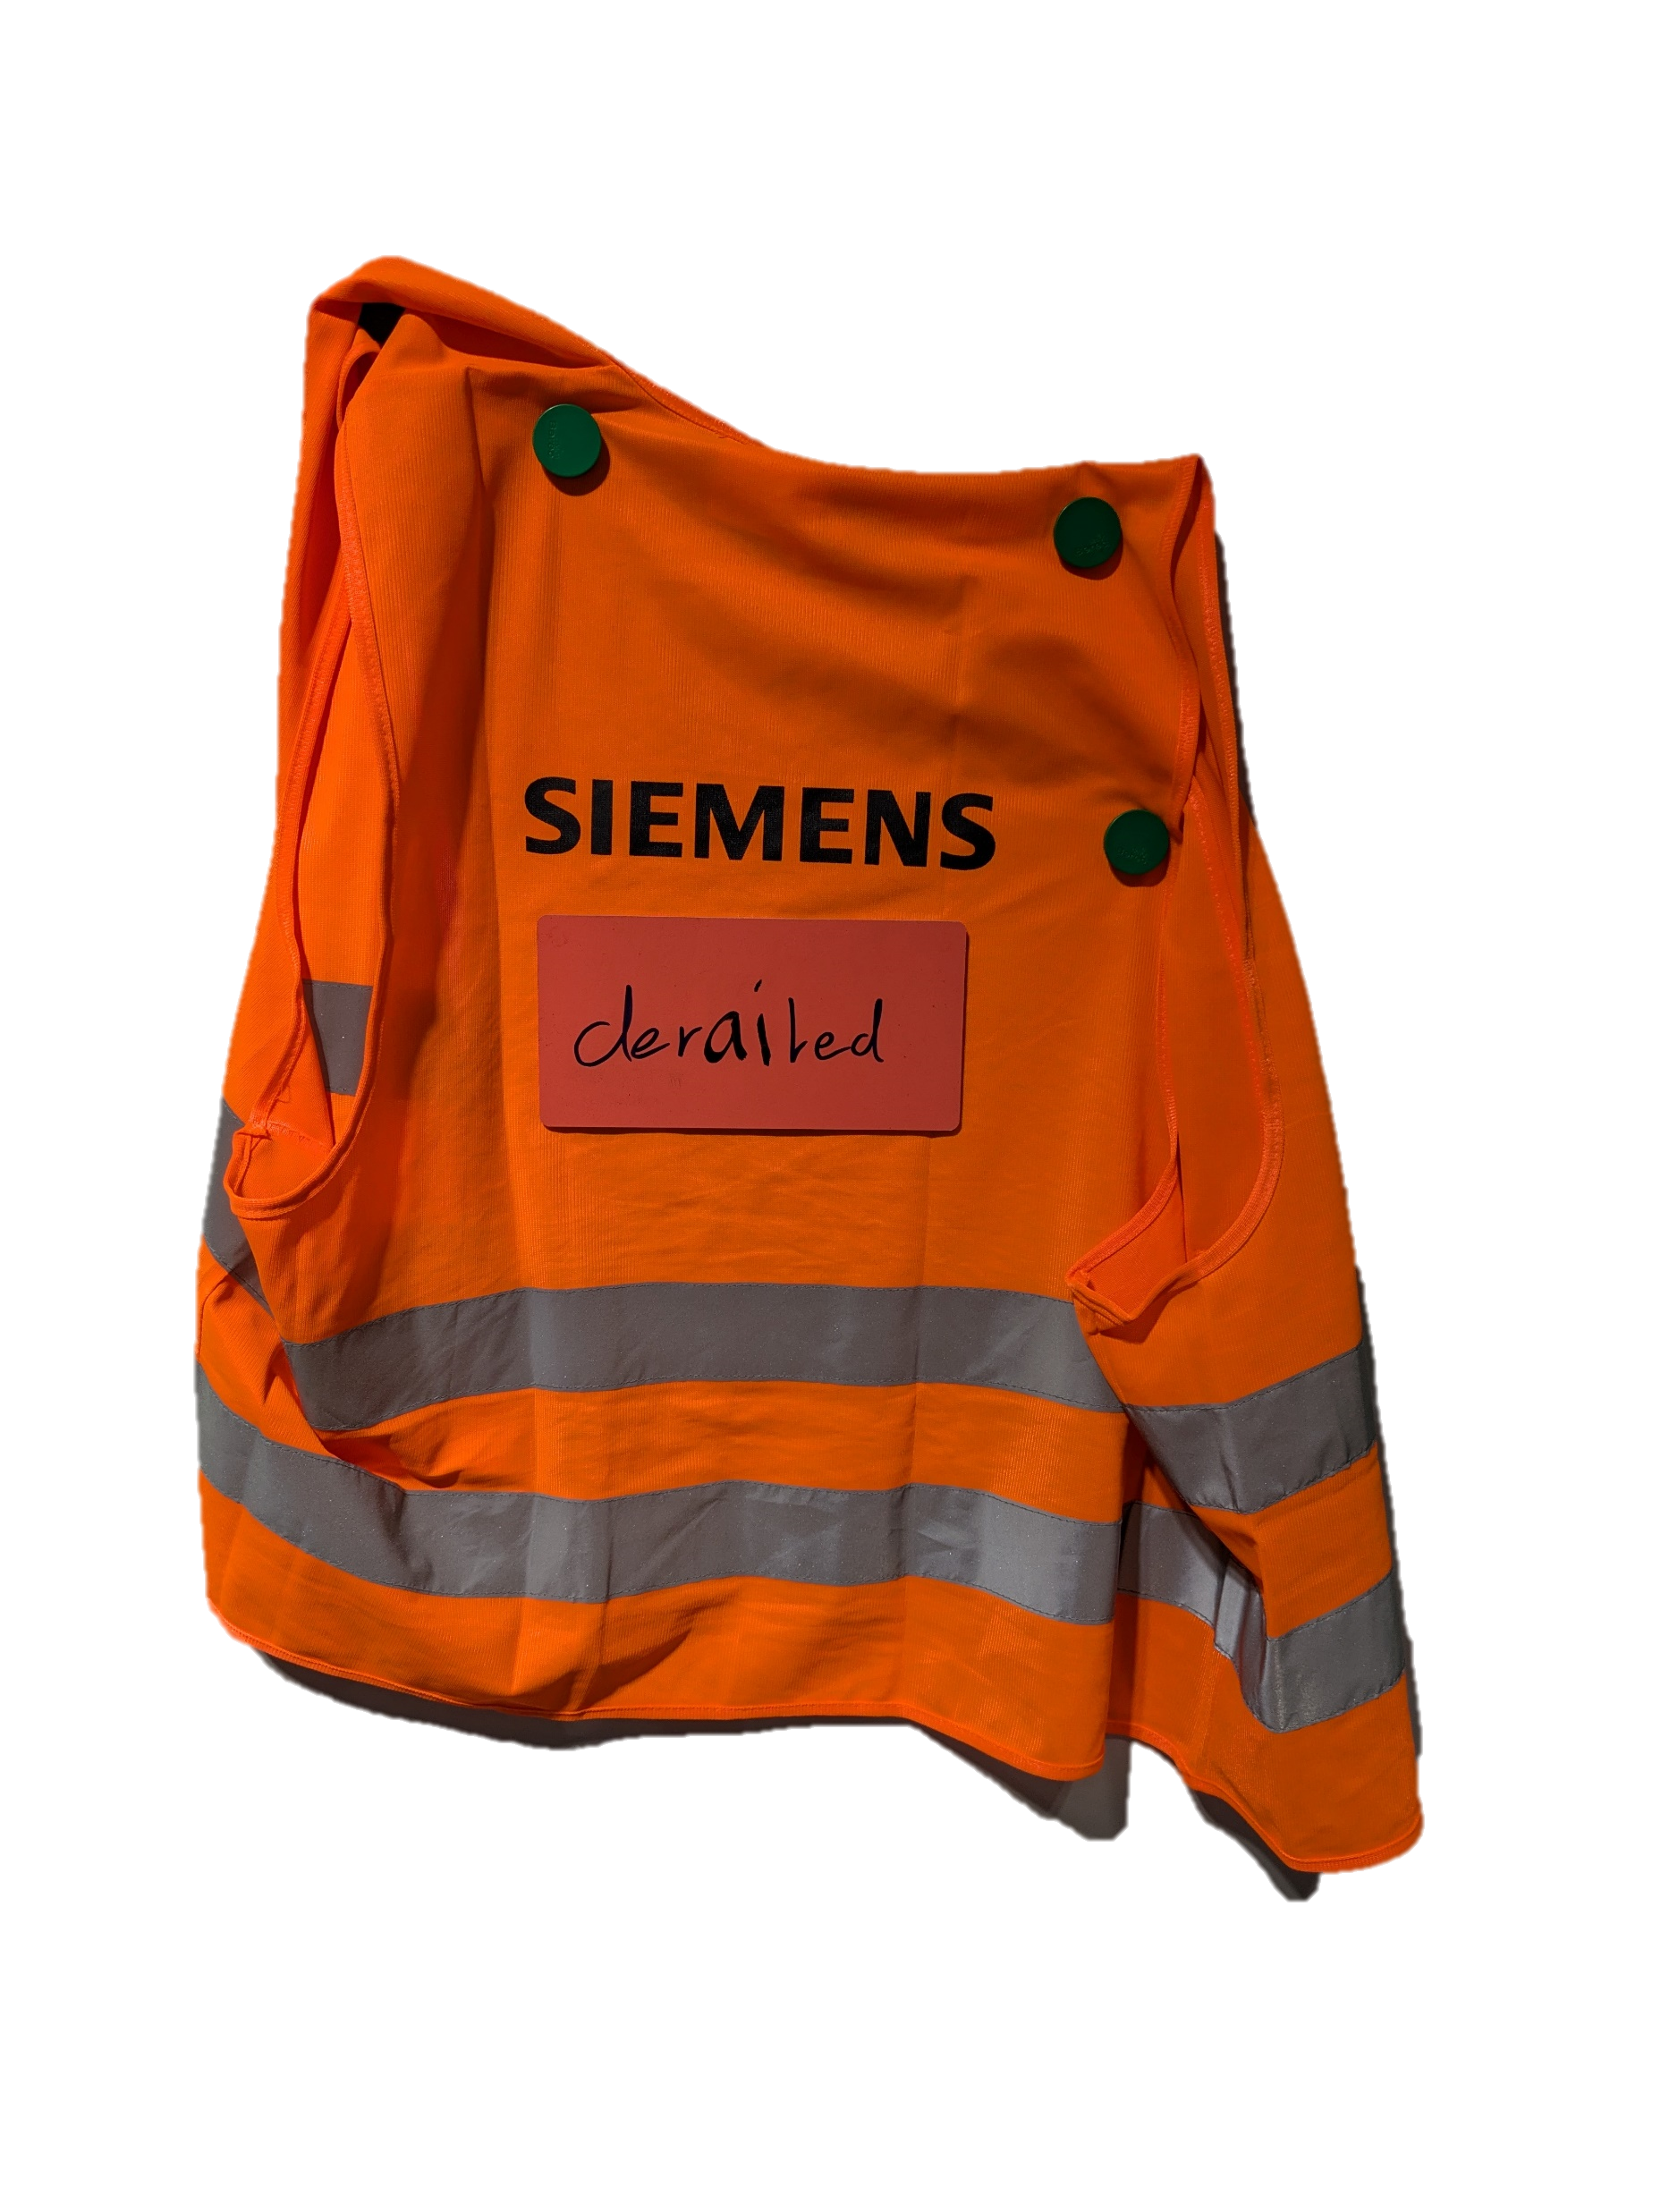

Slide 2
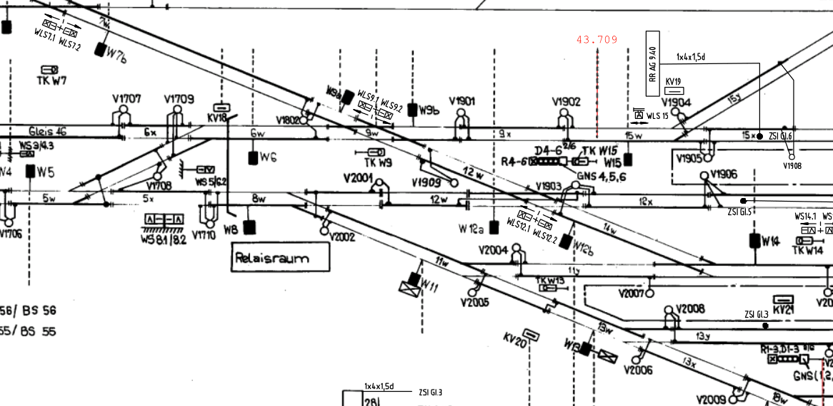
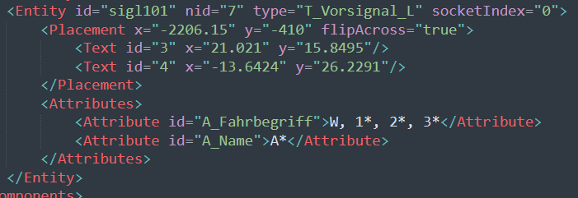
From this ...
To this ...
Handdrawn
Old
Structured
Digital

Slide 3
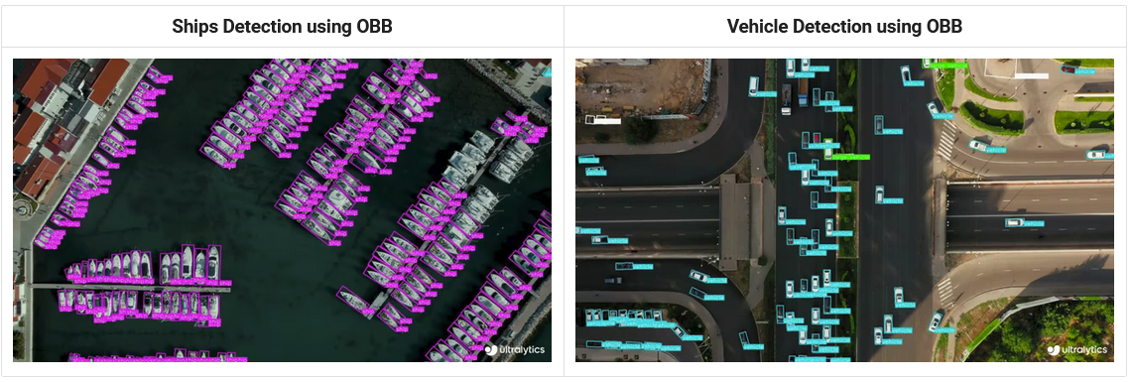
First step: Object detection
OpenCV too unreliable
The solution: YOLO

Slide 4

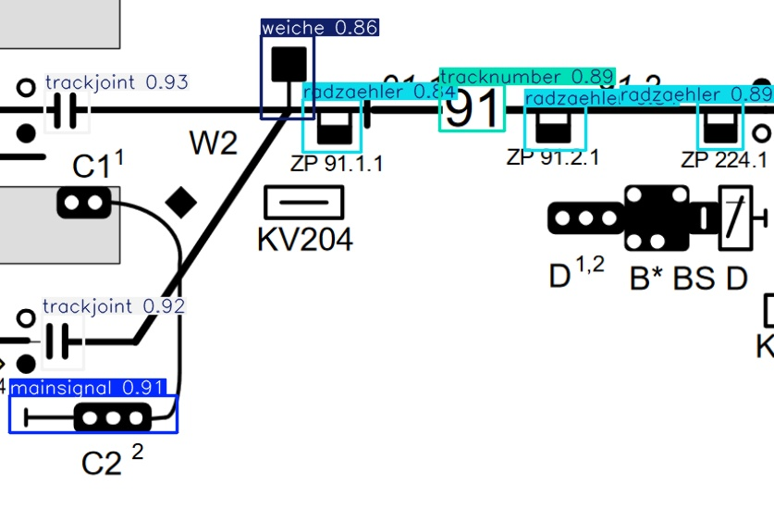
Buuuuut...
We need training data to detect our objects
Manual labelling
We only labelled 5 objects
And tadaaaaa...

Slide 5
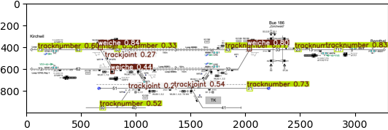
Onto the next problem
YOLO can only handle 640x640 pixels at once.
3 trackjoints, 8 tracknumbers, 3 weiches

Slide 6
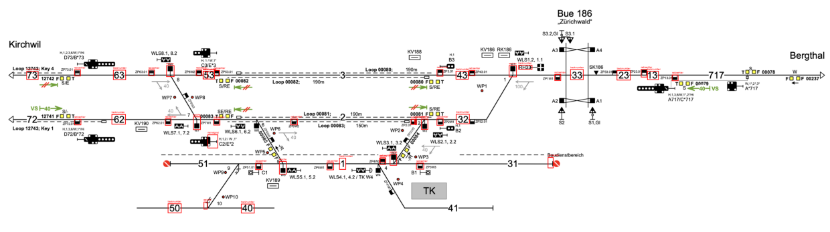
Split the image
Sliding window approach
Symbol: radzaehler, Count: 21 Symbol: tracknumber, Count: 14 Symbol: weiche, Count: 8 Symbol: mainsignal, Count: 1

Slide 7
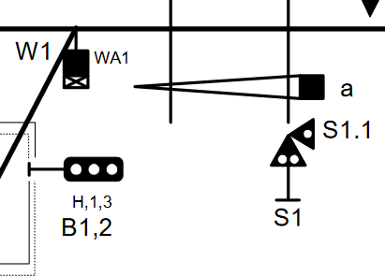
What about the text
Optical character recognition (OCR)
Match with object coordinates
Win
Problem for another day

Slide 8
Structuring the data
Follow the lines
Detect objects
To JSON

Slide 9
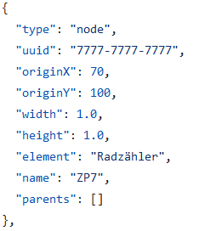
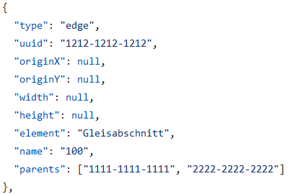
JSON

Slide 10
Visualize

Slide 11
We prove that...
... we can detect object
... we can structure data

